Slide 1


Azure DevOps in Action
Callon Campbell
Systems Architect, Microsoft Azure MVP
Email: | CallonCampbell@Outlook.com
Blog: | https://TheFlyingMaverick.com
Twitter: | @Flying_Maverick

Slide 2
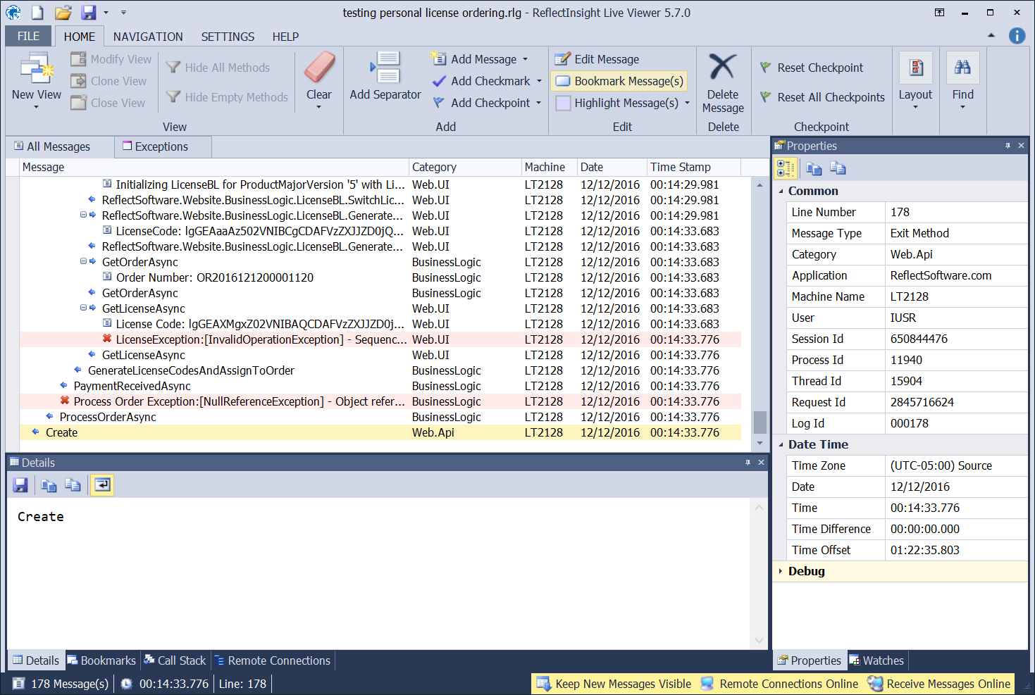
About me
Callon Campbell - Microsoft Azure MVP
Systems Architect and Developer with 20 years of experience developing desktop, mobile and web enterprise applications using .NET, SQL Server, Mobile and Azure technologies.
Co-creator of ReflectInsight, a .NET logging framework and real-time Live Log Viewer.
Email: | CallonCampbell@Outlook.com | Twitter: | @Flying_Maverick
Blog: | http://TheFlyingMaverick.com | LinkedIn: | LinkedIn.com/in/calloncampbell
Website: | http://ReflectInsight.com | Slideshare: | https://www.slideshare.net/calloncampbell

Slide 3
Agenda
What is Azure DevOps?
Azure Pipelines – build, test and deploy (CI and CD)
Azure Artifacts
Wrap up

Slide 4
What is DevOps?
People. Process. Products.
Build& Test
Deploy
DevOps is the union of people, process, and products to enable continuous delivery of value to your end users.
“
Continuous Delivery
Develop
Operate
”
Plan & Track
Monitor & Learn
Notes:
Microsoft definition - DevOps is the union of people, process and products to enable the continuous delivery of value to your end users.

Slide 5


High Performance DevOps Companies Achieve…
46x Deployment
Frequency
2,555x Faster Lead
Time For Changes
Faster
Time to Market
DevOps
$
Increased
Revenue
7x Lower Change
Failure Rate
2,604x Faster Mean
Time to Recover
Source: 2018 Accelerate: State of DevOps: Strategies for a New Economy." N. Forsgren, J. Humble, G. Kim. DevOps Research and Assessment (DORA)
Notes:
More and more businesses are realizing DevOps has become increasingly critical to a team’s success.
Azure DevOps captures over 15 years of investment and learnings in providing tools to support software development teams.

Slide 6
How Microsoft can help
Microsoft Azure is a powerful and flexible foundation for past, present, and future apps – easily build, manage, and deploy any application and any stack on a massive, global network using your favorite tools and frameworks.
Flexible
Powerful
Open
Choice of IaaS, PaaS, public cloud or hybrid.
Mirror or modernize app infrastructure with VMs, containers, microservices or serverless.
Supports all stages of the app modernization journey – from lift-and-shift to Cloud-Native.
Instantly improve the performance, scalability and resiliency of your apps by moving them to the cloud.
Increase business agility with Cloud-Native capabilities and built-in DevOps for continuous innovation.
Bring your stack, we bring a cloud that runs any app, on any platform, and any language.
Build applications using the language and tools of your choice - Azure supports what you already use and love so you can get up and running fast – just bring code.

Slide 7
What technologies do I need to support DevOps?
DevOps brings together people, processes, and technology, automating software delivery to provide continuous value to your users. Using Azure DevOps, you can deliver software faster and more reliably - no matter how big your IT department or what tools you’re using.
Continuous Integration (CI)
Improve software development quality and speed.
When you use Azure Pipelines or Jenkins to build apps in the cloud and deploy to Azure, each time you commit code, it’s automatically built and tested and bugs are detected faster.
Continuous Deployment (CD)
By combining continuous integration and infrastructure as code (IaC), you’ll achieve identical deployments and the confidence to deploy to production at any time.
With continuous deployment, you can automate the entire process from code commit to production if your CI/CD tests are successful.
Continuous Learning & Monitoring
With Azure Application Insights you can identify how your applications are performing and test if the recent deployment made things better or worse.
Using CI/CD practices, paired with monitoring tools, you’ll be able to safely deliver features to your customers as soon as they’re ready.
Notes:
Using Azure DevOps, you can deliver software faster and more reliably - no matter how big your IT department or what tools you’re using.

Slide 8





Introducing Azure DevOps
Azure Boards
Azure Pipelines
Azure Repos
Deliver value to your users faster using proven agile tools to plan, track, and discuss work across your teams.
Build, test, and deploy with CI/CD that works with any language, platform, and cloud. Connect to GitHub or any other Git provider and deploy continuously.
Get unlimited, cloud-hosted private Git repos and collaborate to build better code with pull requests and advanced file management.
Azure Test Plans
Azure Artifacts
➔
Test and ship with confidence using manual and exploratory testing tools.
Create, host, and share packages with your team, and add artifacts to your CI/CD pipelines with a single click.
https://azure.com/devops
Notes:
Azure DevOps is The evolution of Visual Studio Team Services (VSTS) and TFS.
Azure DevOps was previously named Visual Studio Team Services but has since out grown being tied exclusively to Visual Studio. Azure DevOps is focused on Azure and the Open Source Community.
VSTS users will be upgraded into Azure DevOps projects automatically. For existing users, there is no loss of functionally, simply more choice and control. The end to end traceability and integration that has been the hallmark of VSTS is all there.
Today’s talk will focus exclusively on Azure Pipelines and Azure Artifacts.

Slide 9

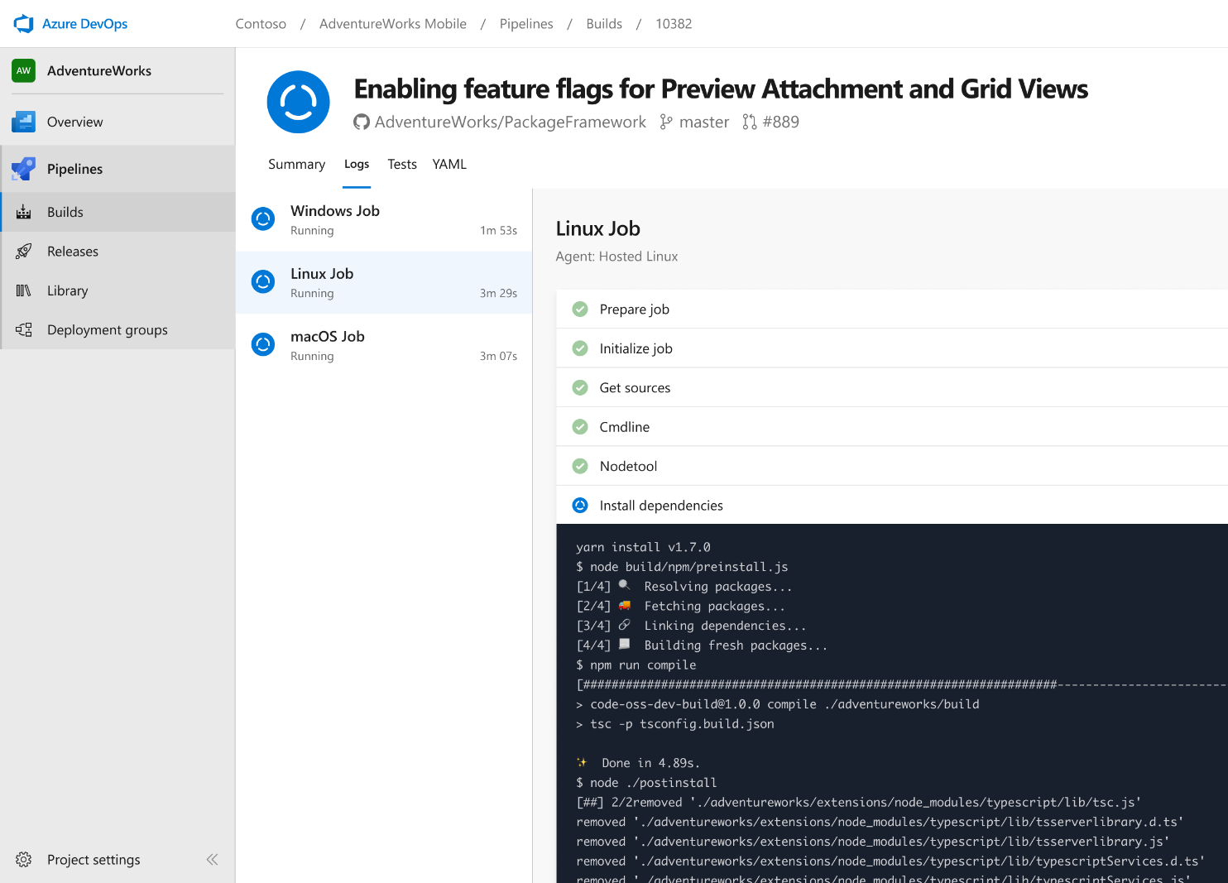


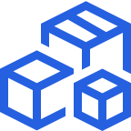

Azure Pipelines
Cloud-hosted pipelines for Linux, Windows and macOS, with unlimited minutes for open source
Any language, any platform, any cloud
Build, test, and deploy Node.js, Python, Java, PHP, Ruby, C/C++, .NET, Android, and iOS apps. Run in parallel on Linux, macOS, and Windows. Deploy to Azure, AWS, GCP or on-premises
Extensible
Explore and implement a wide range of community-built build, test, and deployment tasks, along with hundreds of extensions from Slack to SonarCloud. Support for YAML, reporting and more
Containers and Kubernetes
Easily build and push images to container registries like Docker Hub and Azure Container Registry. Deploy containers to individual hosts or Kubernetes.
Best-in-class for open source
Ensure fast continuous integration/continuous delivery (CI/CD) pipelines for every open source project. Get unlimited build minutes for all open source projects with up to 10 free parallel jobs across Linux, macOS and Windows
➔
https://azure.com/pipelines
Notes:
Azure Pipelines is the perfect launchpad for your code – automating your builds and deployments so you spend less time with the nuts and bolts and more time being creative

Slide 10


Microsoft Open Source
2018
VS Code ranked #1 developer tool
Service Fabric Open Sourced
Azure Sphere with Linux kernel
Intent to acquire GitHub announced
~5,000 Microsoft employees committing to open source projects on GitHub
Azure trending to 50% Linux
Microsoft continues as largest contributor to OSS on GitHub
“Judge us by the actions we have taken in the recent past, our actions today and in the future”
—Satya Nadella, CEO Microsoft
2017
Microsoft Azure Kubernetes Service launched
Draft, Brigade, Kashti projects submitted to Kubernetes community
Microsoft joins Cloud Native Computing & Cloud Foundry Foundations
SQL 2017 on Linux
Windows source code moved to Git
Azure Databricks (Apache Spark) announced
2016
.NET Core 1.0
PowerShell Core
Windows Subsystem for Linux in Windows 10
Microsoft joins Linux foundation
GitHub recognizes Microsoft as a top open source contributor
2015
VS Code released
HDInsight (Hadoop/ Ubuntu) announced
Microsoft jointly forms Node.js foundation
2014
Satya “Microsoft loves Linux”
Microsoft org on GitHub created
.NET foundation created
2012
Typescript released
Git added to TFS and Visual Studio
2012
2014
2015
2016
2017
2018
Notes:
Microsoft start contributing to OSS earlier than 2012. It’s first OSS project was in 2004 when the Windows Installer Toolkit (WiX) was released to SourceForge.
They also started contributing to the Linux kernel in 2009.

Slide 11


Azure Pipelines
Microsoft Open Source
Free unlimited build minutes for public projects
Up to 10 free parallel jobs across Windows, Linux and macOS
➔
https://azure.com/pipelines
Notes:
Open Source projects receive free CI/CD with Azure Pipelines
All the builds you need, using the power of Azure you get one service that gives you unlimited build minutes and 10 parallel jobs where you can build on Windows, Mac, and Linux using a single build YAML file.
And…Azure Pipelines is great for all types of projects.

Slide 12

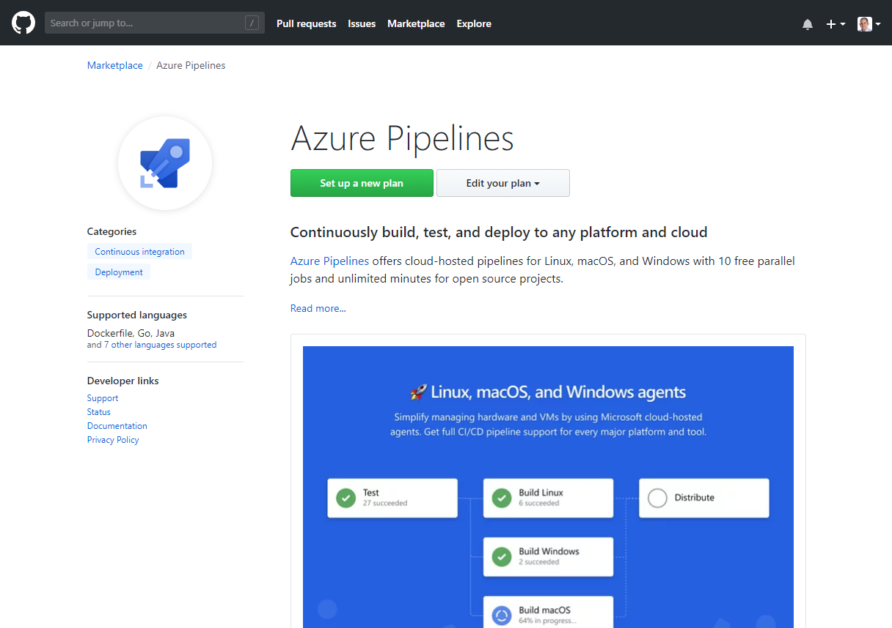
Integrated with GitHub
Azure Pipelines available now to any developer from the GitHub Marketplace
Notes:
Azure Pipelines is now available to anyone from the GitHub Marketplace.

Slide 13


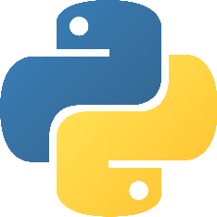

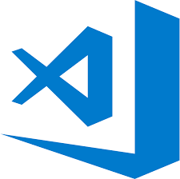
Early adopters
GitHub projects already powered by Azure Pipelines for CI
atom/atom
python/cpython
dotnet/reactive
microsoft/vscode
Notes:
Many of the top open source projects are already using Azure Pipelines for CI/CD, such as Atom, CPython, Pipenv, Tox, Visual Studio Code, and TypeScript – and the list keeps growing every day.

Slide 14
Creating your first DevOps project
#AzureDevOps
DevOps project Demo
Notes:
So let’s get started with some demos.

Slide 15
Create your first Pipeline
#AzureDevOps
Azure Pipelines Demo 1

Slide 16
GitHub + Azure Pipelines
#AzureDevOps
Azure Pipelines Demo 2

Slide 17
Azure DevOps
Azure Boards
Azure Pipelines
Azure Repos
Deliver value to your users faster using proven agile tools to plan, track, and discuss work across your teams.
Build, test, and deploy with CI/CD that works with any language, platform, and cloud. Connect to GitHub or any other Git provider and deploy continuously.
Get unlimited, cloud-hosted private Git repos and collaborate to build better code with pull requests and advanced file management.
Azure Test Plans
Azure Artifacts
➔
Test and ship with confidence using manual and exploratory testing tools.
Create, host, and share packages with your team, and add artifacts to your CI/CD pipelines with a single click.
https://azure.com/devops
Notes:
So does TFS

Slide 19
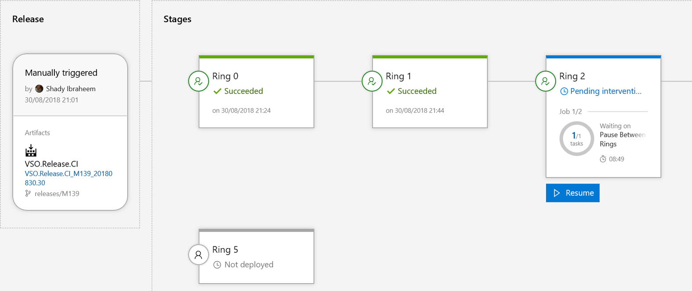
Azure Pipeline releases
Azure Pipelines releases is a service in Azure Pipelines and Team Foundation Server (TFS 2015.2 and later) and an essential element of DevOps CI/CD that helps your team continuously deliver software to your customers at a faster pace and with lower risk.
You can fully automate the testing and delivery of your software in multiple stages all the way to production, or set up semi-automated processes with approvals and on-demand deployments.

Slide 20
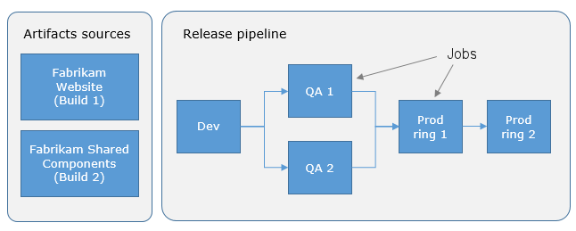
Release pipelines and release names
A release pipeline is one of the fundamental concepts in Azure Pipelines for your DevOps CI/CD processes. It defines the end-to-end release pipeline for an application to be deployed across various stages.
You start using Azure Pipelines releases by authoring a release pipeline for your application. To author a release pipeline, you must specify the artifacts that make up the application and the release pipeline.
An artifact is a deployable component of your application. It is typically produced through a Continuous Integration or a build pipeline. Azure Pipelines releases can deploy artifacts that are produced by a wide range of artifact sources such as Azure Pipelines build, Jenkins, or Team City.
You define the release pipeline using stages, and restrict deployments into or out of an stage using approvals. You define the automation in each stage using jobs and tasks. You use variables to generalize your automation and triggers to control when the deployments should be kicked off automatically.
Notes:
A release pipelines defines the end-to-end process for an application to be deployed across different stages.
An artifact is the output of your build and is a deployable component to your application. Artifacts can be produced from many sources like Azure Pipelines, Jenkins, or TeamCity.
Finally the release pipeline is defined by stages that restrict the deployment using approvals and/or gates. You define the automation in each stage using jobs and tasks.

Slide 21
Create pipeline release and configure continuous deployment
#AzureDevOps
Azure Pipeline Demo 3
Notes:
Demo WindowsServiceFramework

Slide 22

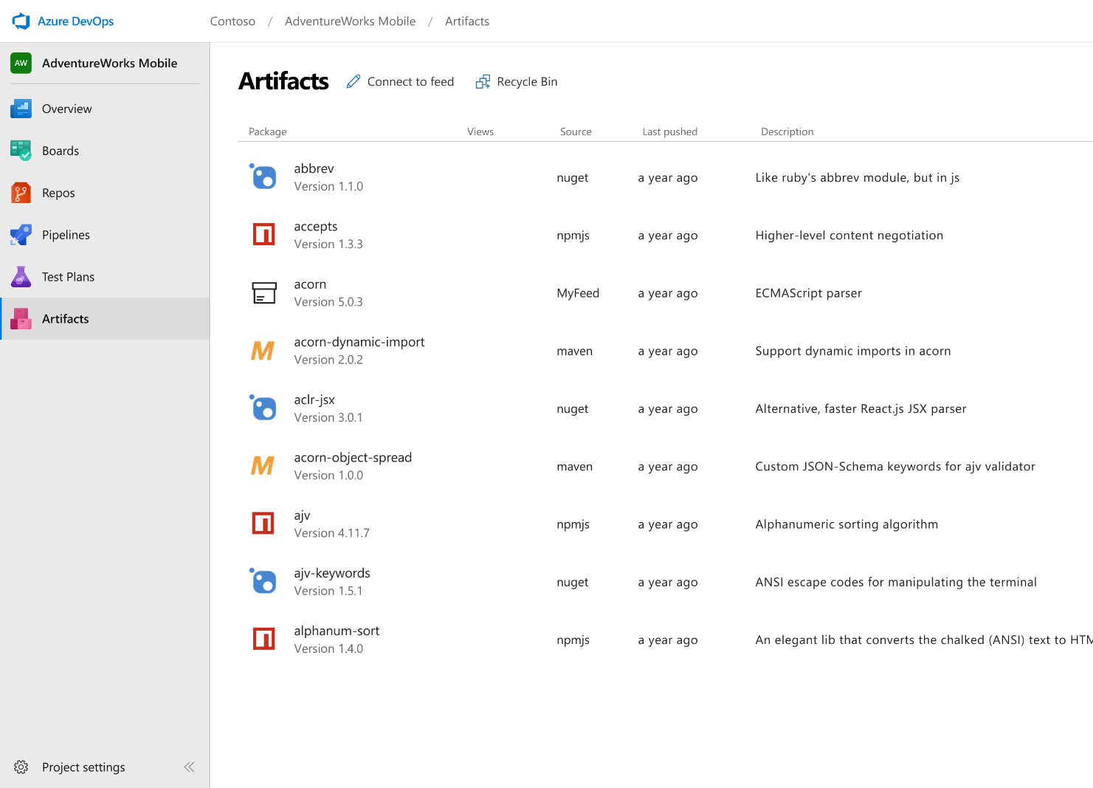



Azure Artifacts
Create and share Maven, npm, and NuGet package feeds from public and private sources – fully integrated into CI/CD pipelines
Manage all package types
Get universal artifact management for Maven, npm, and NuGet.
Add packages to any pipeline
Share packages, and use built-in CI/CD, versioning, and testing.
Share code efficiently
Easily share code across small teams and large enterprises.
➔
https://azure.com/devops
Notes:
With Azure Artifacts you can add fully integrated package management to your continuous integration/continuous delivery (CI/CD) pipelines with a single click.
Keep your artifacts organized
Create and share Maven, npm, and NuGet packages from public and private sources with teams of any size. And there is no need to store binaries in Git – simply store them using Universal Packages.
Protect your packages
Keep every public source package you use—including packages from npmjs and nuget.org—safe in your feed where only you can delete it, and where it’s backed by the enterprise-grade Azure SLA.

Slide 23
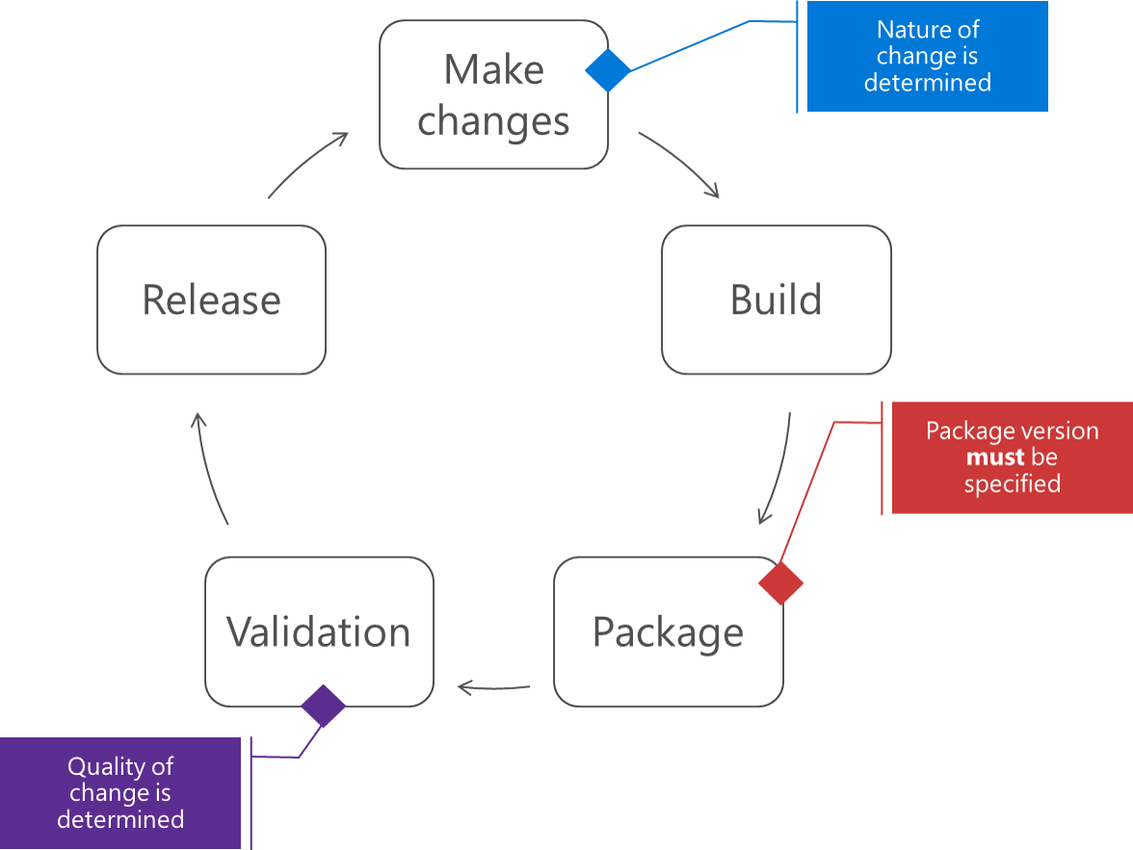
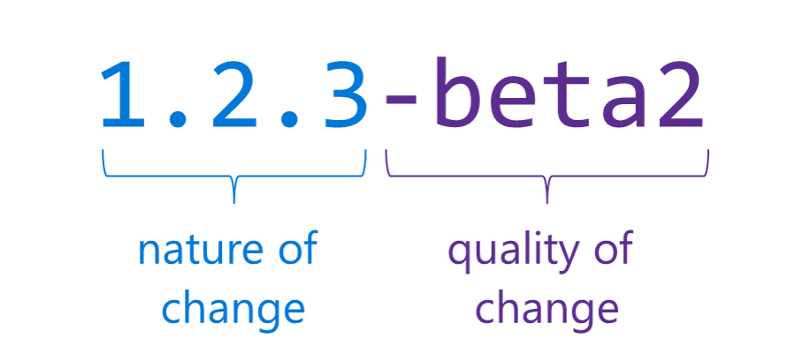
Package management
Package management is broadly used in our programming world. In .NET, we use NuGet to share our packages with the world or our internal departments.
Versioning NuGet packages as part of your Continuous Delivery process has some challenges. In order to control the quality of our packages, the most common mechanism is Semantic Versioning or SemVer.
The difficult part about this mechanism, is that you need to version your package before you actually know the quality of the package.
Notes:
When creating packages in continuous integration and delivery scenarios, it's important to convey 3 pieces of information: the nature of the change, the risk of the change, and the quality of the package.

Slide 24
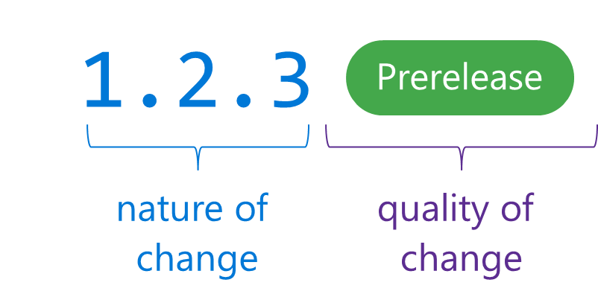
Introducing release views
Because Semantic Versioning has some downsides, the VSTS team (now Azure DevOps) introduced a new feature as part of the package management called Release Views.
Release views enable you to communicate the quality of a package after it’s been validated.

Slide 25
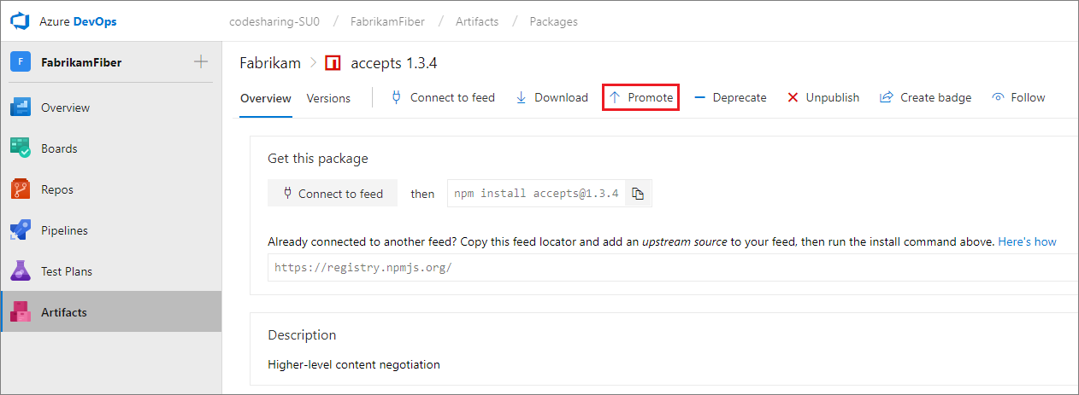
Promote your package to the correct view
When a package is created, it will populate the @local view.
When a package is ready for early adopters, select that package and its dependency graph and promote it to the @prerelease view.
When the package is deemed of sufficient quality to be released, promote that package and its dependency graph into the @release view.
Promoting package versions to a view ensures they won't be deleted by retention policies.

Slide 26
Create artifacts feed
#AzureDevOps
Azure Artifacts Demo 1
Notes:
Demo WindowsServiceFramework

Slide 27
Create build artifacts
#AzureDevOps
Azure Artifacts Demo 2
Notes:
Demo WindowsServiceFramework

Slide 28
Create release pipeline
#AzureDevOps
Azure Artifacts Demo 3
Notes:
Demo WindowsServiceFramework and automatic deployment to Nuget.org

Slide 29
Changes for existing VSTS / TFS customers
The same functionality you know and love today, with greater openness, flexibility and focus
Existing Accounts
Existing https://contoso.visualstudio.com URL continues to work. https://dev.azure.com/contoso available for opt-in.
New UI opt-in per user as preview feature. Will start advertising new UI once feedback from new accounts and early adopters has been incorporated.
Can disable services on a per project basis for new UI
New Azure branding in communications and documentation (emails, alerts etc).
Websites and documentation will move from Visual Studio to Azure based locations (with redirects in place).
Redirects available for some time.
TFS will remain the on-premises brand until the next major version in 2019. The new UI will be enabled in that release.
Existing TFS branded information and downloads remain in Visual Studio locations until next release.
Pricing
Public project usage is now free.
The free tier for Pipelines now includes 1,800 minutes per month, up from 240.
Pipelines can be used independently from Repos — so if you are only using Pipelines and your repos are hosted on GitHub you don’t need to pay for Repos or Boards (Basic) users.
New Accounts
https://dev.azure.com/contoso based URL.
New navigation & branding by default.
Notes:
The functionality you know and love today remains and will continue to be actively expanded on at the same rapid cadence as you are used to. The services will get even more open and extensible with more choice to your workflows. You will be able to move to the new UI when it works for you and your team
Existing Accounts
https://myorg.visualstudio.com continues to work but new https://dev.azure.com/myOrg address also available for opt-in.
New UI opt-in per user. Will start advertising new UI once feedback from new accounts and early adopters has been incorporated.
Can disable services on a per project basis
New Azure branding in communications and documentation (emails, alerts etc).
Websites and documentation will move from Visual Studio to Azure based locations (with redirects in place).
Redirects available for some time.
TFS will remain the on-premises brand until we ship the next major version in 2019. Existing TFS branded information and downloads remain in Visual Studio locations until next release. The new UI will be available in that release.
Pricing
A few key changes:
Public project usage is free.
The free tier for Pipelines now includes 1,800 minutes per month, up from 240.
Pipelines can be used independently from Repos—so if your repos are hosted on GitHub you don’t need to pay for Repos & Boards (Basic) for your users.
New Accounts
https://dev.azure.com/myOrg based URL.
New UI by default.

Slide 30
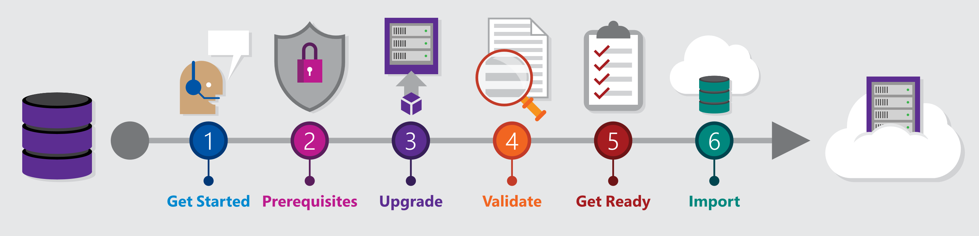
Migrating from TFS to Azure DevOps
Move from Team Foundation Server to Azure DevOps and bring your data along
Benefits of Cloud Hosted Azure DevOps Services
Global availability
Hosted and maintained by Microsoft with 99.9% uptime guarantee and 24x7 support
Immediate access to latest features
Simplified deployment to Azure
TFS Import Service
Fully supported high fidelity migration path
Trusted by many large enterprises
Now faster and easier to use
➔
https://aka.ms/tfsimport

Slide 31
Azure DevOps
Better together
Azure Boards
Azure Repos
Azure Pipelines
Azure Test Plans
Azure Artifacts
An end-to-end solution for organizations looking for an enterprise-grade toolchain
Fully Integrated with end to end traceability
Scalable to any team and project size
Highly available, multi region, hybrid cloud & on-prem
Customer Support
Consistent admin and access control
➔
https://azure.com/devops
Notes:
Although we only covered Azure Pipelines and Azure Artifacts, Azure DevOps is an end-to-end solution for organizations looking for enterprise-grade toolchain, or use just what you need for that garage project you have.

Slide 32






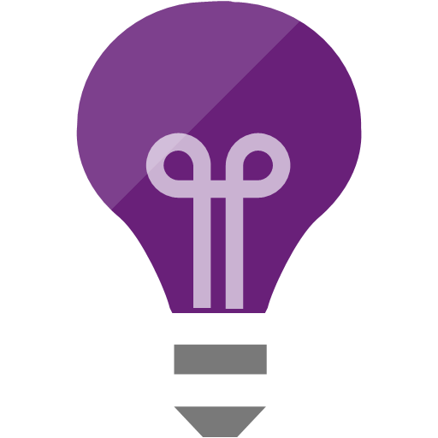


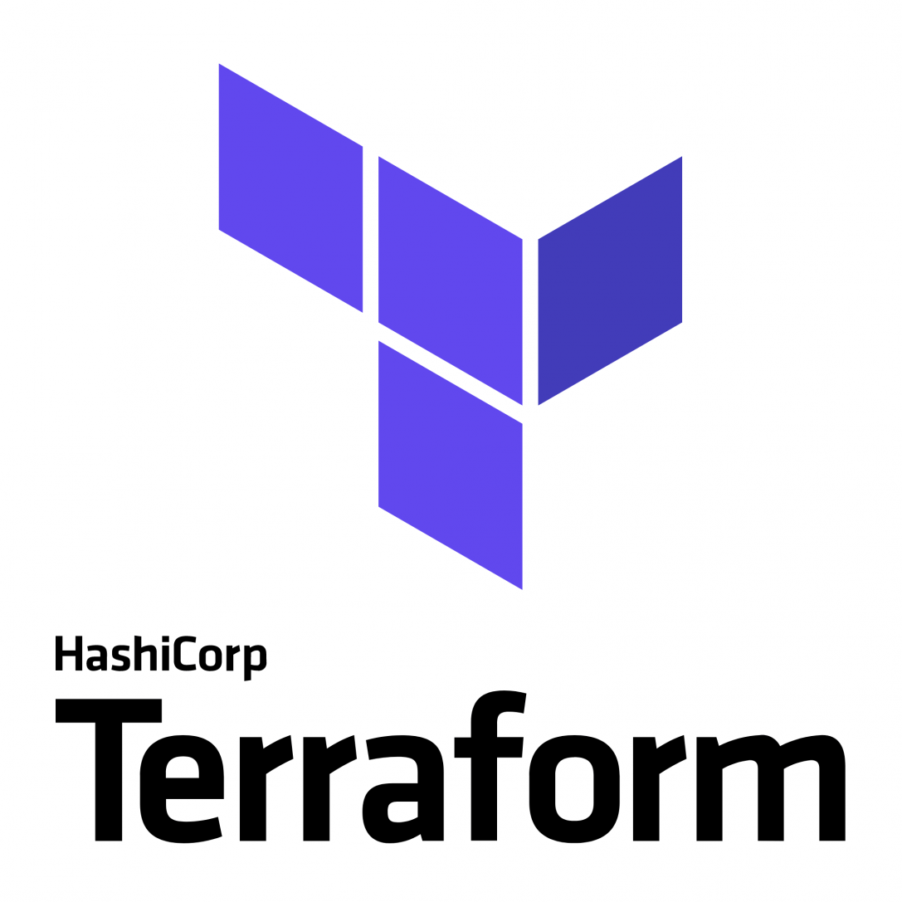
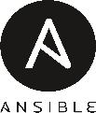


Broadening the Azure Ecosystem
Notes:
Azure DevOps and TFS are about broadening the Azure ecosystem.

Slide 33




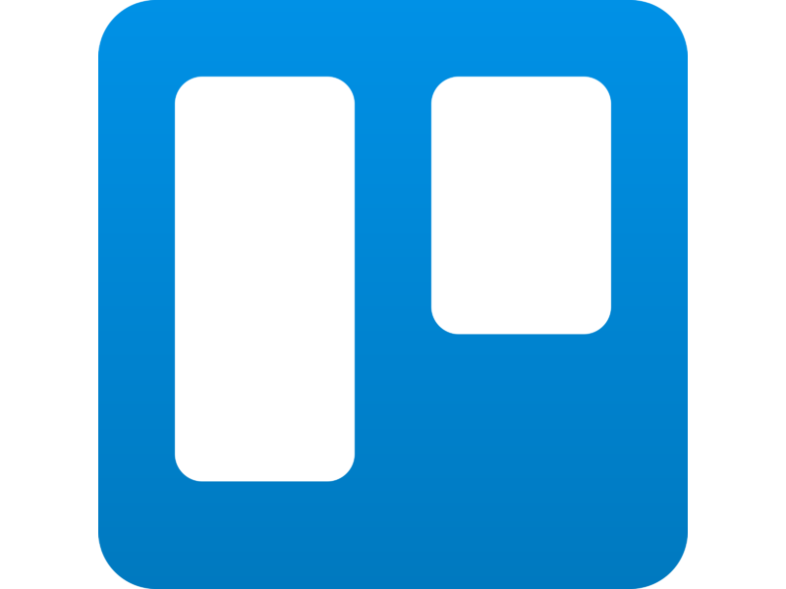
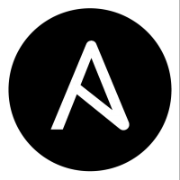

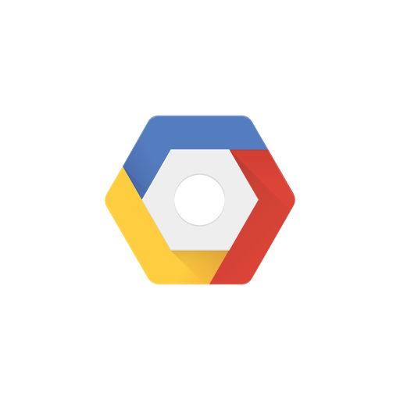

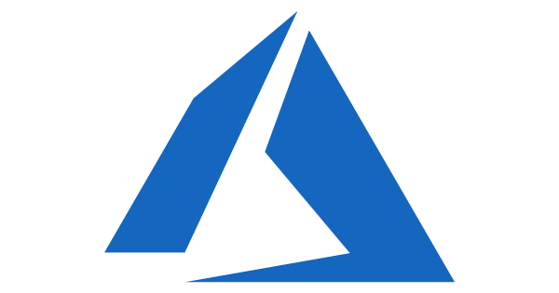

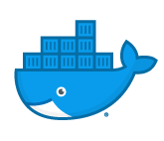
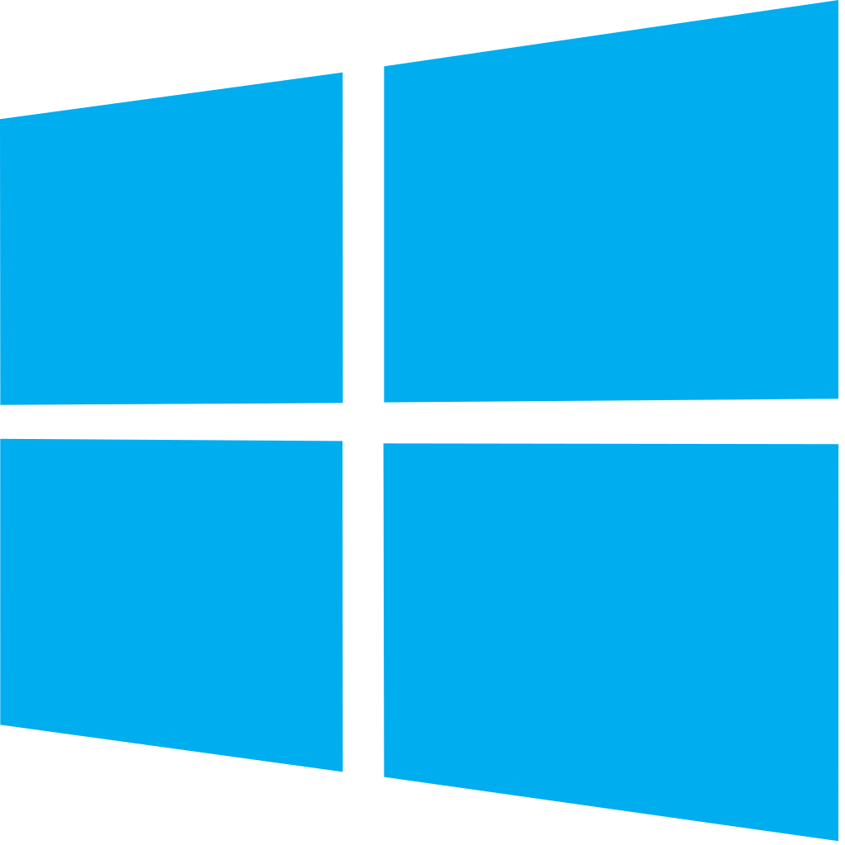


Azure DevOps: Choose the tools and clouds you love
Azure DevOps lets developers choose the tools that are right for them
Mix and match to create workflows with tools from Microsoft, open source or your favorite 3rd party tools
Target any cloud, on-prem or both and deploy to the servers you need

Slide 34





Azure DevOps
Plan smarter, collaborate better, and ship faster with a set of modern dev services
Any developer, any platform, any cloud. Full support for hybrid cloud, on-premises & containers.
Use all the Azure DevOps services or choose just what you need to complement your existing workflows
Best in class builds for open source. Free unlimited build minutes for public projects and up to 10 free concurrent jobs across Windows, Linux and macOS
Get started for free for small teams, scales to support the largest enterprises
Azure Boards
Azure Repos
Azure Pipelines
Azure Test Plans
Azure Artifacts
Start free today
➔
https://azure.com/devops
Notes:
Azure DevOps is really about any developer, any platform, any cloud. Use all the services or just the ones you need. Azure DevOps is also the best in class builds for open source.

Slide 35
Azure DevOps Services Pricing
Open Source Projects
Small Teams
Teams of any size
Free
Unlimited users and build time
Azure Pipelines: 10 parallel jobs with unlimited minutes for CI/CD
Azure Boards: Work item tracking and Kanban boards
Azure Repos: Unlimited public Git repos
Free
Start free with up to 5 users
Azure Pipelines: Run 1 Microsoft-hosted job for 1,800 minutes per month and 1 self-hosted job for any amount of time
Azure Boards: Work item tracking and Kanban boards
Azure Repos: Unlimited public Git repos
Azure Artifacts: package management
Unlimited stakeholders
Starts at $6 per user, per month for Boards & Repos*
Easy pricing that grows with your team
Azure Pipelines: Run 1 Microsoft-hosted job for 1,800 minutes per month and 1 self-hosted job for any amount of time
Azure Boards: Work item tracking and Kanban boards
Azure Repos: Unlimited public Git repos
Azure Artifacts: package management
Unlimited stakeholders
Boards & Repos included for Visual Studio subscribers
*
https://azure.com/pricing/details/devops/
5 Boards & Repos users and 5 Artifacts users free. Pipelines with unlimited minutes, Test Plans users and additional Artifacts users also available. Please see the Azure pricing calculator for details.
➔

Slide 36
References
Azure DevOps Documentation
Introducing Azure DevOps
Best practices for using Azure Artifacts
Communicate package quality with release views
Area | Destination URL
Azure DevOps | https://azure.microsoft.com/services/devops/
Azure Pipelines | https://azure.microsoft.com/services/devops/pipelines/
Azure Boards | https://azure.microsoft.com/services/devops/boards/
Azure Repos | https://azure.microsoft.com/services/devops/repos/
Azure Artifacts | https://azure.microsoft.com/services/devops/artifacts/
Azure Test Plans | https://azure.microsoft.com/services/devops/test-plans/

Slide 37




Thank you. Questions?
#AzureDevOps
https://azure.com/devops
@AzureDevOps
https://aka.ms/AzureDevOpsForum
https://aka.ms/DevOpsBlog/
Notes:
Join the conversation.
Potentially replace for speaker contact details / intro.

Slide 38
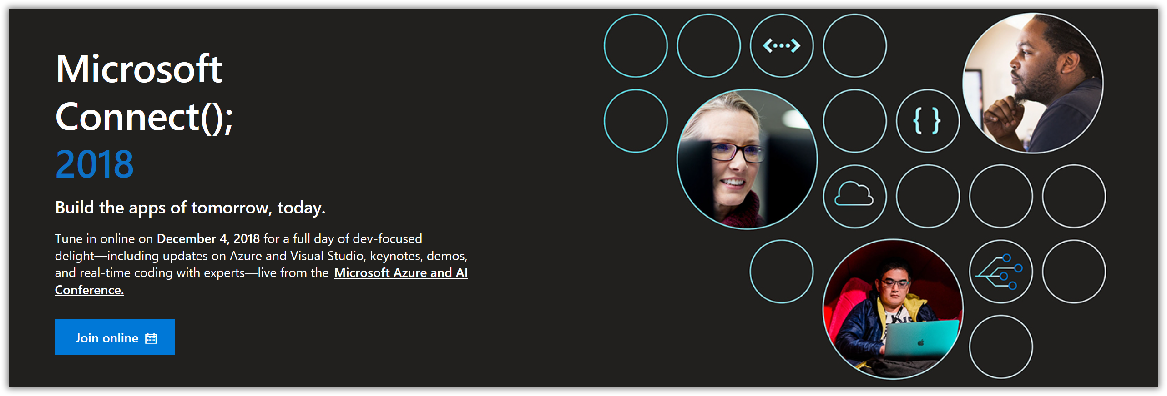
Upcoming events
https://www.microsoft.com/en-us/connectevent/
Notes:
Connect(); 2018 is a free virtual event where developers from around the world come together and get inspired to build the apps of tomorrow, today. Tune in to hear the latest on Azure and Visual Studio with keynotes, demos, live coding sessions, Q&A and on-demand sessions.

